Slide 1



Lawyer Client Management System
LAWBRIDGE
TEAM MEMBERS
GURUPRASAD H D
NITHYA
LAKSHMI H R

Slide 2

CONTENTS
1. Introduction
2. Objectives
3. Company Profile
4. Modules Overview
5. System Features
6. Tools & Technologies
7. System Design
8. Screenshots / UI Demo
9. Challenges & Solutions
10. Learnings & Outcomes
11. Conclusion

Slide 3

Introduction
The Lawyer Client Management System is a web-based application
designed to streamline the interaction between lawyers and their clients.
It centralizes case management, client details, communication, and scheduling
in a secure and user-friendly interface.
01

Slide 4


Overview
1
System Overview
To automate and simplify routine legal operations
To bridge the communication gap between lawyers and clients
To ensure secure and easy access to legal data
2
Traditional legal practices often rely on manual records
Growing need for digital transformation in law firms
Helps lawyers manage workload efficiently and focus on core legal tasks
Need in Legal

Slide 5

02
Objectives
1. Streamline Legal Operations
2. Enhance Lawyer-Client Interaction
3. Improve Data Organization
4. Ensure User-Friendly Experience
5. Provide Real-Time Insights

Slide 6



System Goals
Management
2
Manage cases, clients, schedules, and documents.
Interaction
Simplify lawyer-client interactions.
1
Security
3
Secure user authentication and data handling.

Slide 7

03
Company Profile

Slide 8



About LawBridge
Services
Legal Practice Management Software
Case and document management systems
Client relationship portals
Secure messaging and scheduling tools
Custom legal workflow automation
About us
2
LawBridge is a legal-tech firm dedicated to transforming how legal professionals manage their clients and cases. The company focuses on building intelligent, secure, and scalable digital solutions for the legal industry..
1
Roles
3
Admin
Lawyers
Clients.

Slide 9

04
Modules Overview

Slide 10




System Modules
Admin Panel
Lawyer Dashboard
Client Access
Authentication System
Manage lawyer and client accounts
Monitor system usage and security
Approve or deactivate users
View and manage assigned cases
Access client details
Visualize case status via intUpdate case progress and schedule meetings
eractive charts
Secure login to view personal case details
Communicate with assigned lawyer
Track case updates and schedules
Role-based login (Admin, Lawyer, Client)
Secure registration and session handling
Password protection and validation

Slide 11

05
System Features

Slide 12


Key Features
1
2
3
4
User
Case
Client
System
registration/login
management
tracking
Schedule and message
5
Dashboard
Interactive with charts

Slide 13

06
Tools & Technologies

Slide 14

Technical Stack
1
Frontend
2
Backend
HTML, CSS, JavaScript, Bootstrap
Spring Boot
3
Database
4
Others
MySQL
Chart.js (or Recharts), Font Awesome icons

Slide 15

07
System Design

Slide 16
Architecture
1
Flowchart
User Registers/Login
Role-Based Dashboard
Lawyer Client Admin
View Cases View Lawyer Manage Users
Manage Clients Book Appt. Manage Data
Send Msgs Chat Lawyer View Logs
Spring Boot APIs
MySQL: Cases, Clients, Users

Slide 17
08
Screenshots / UI Demo

Slide 18

UI Components
1
2
3
4
Authentication
Dashboard
Management
Navigation
Login/Register page
Lawyer Dashboard
Case/Client pages
Charts and sidebar navigation

Slide 19
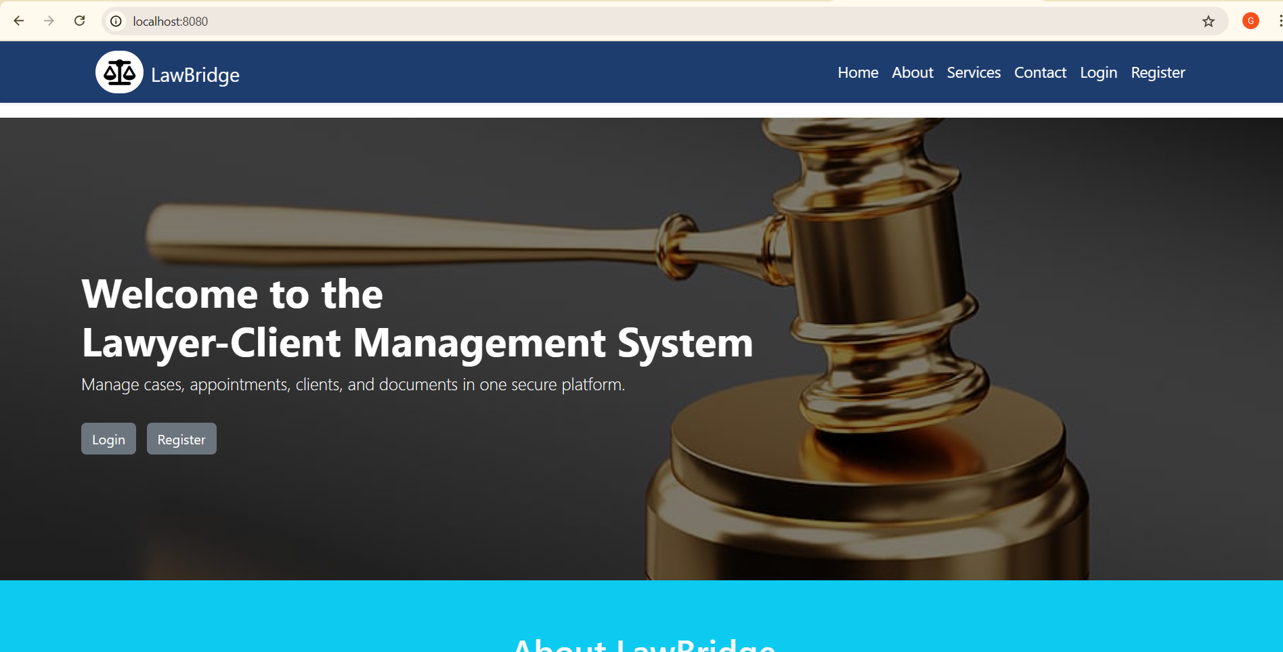
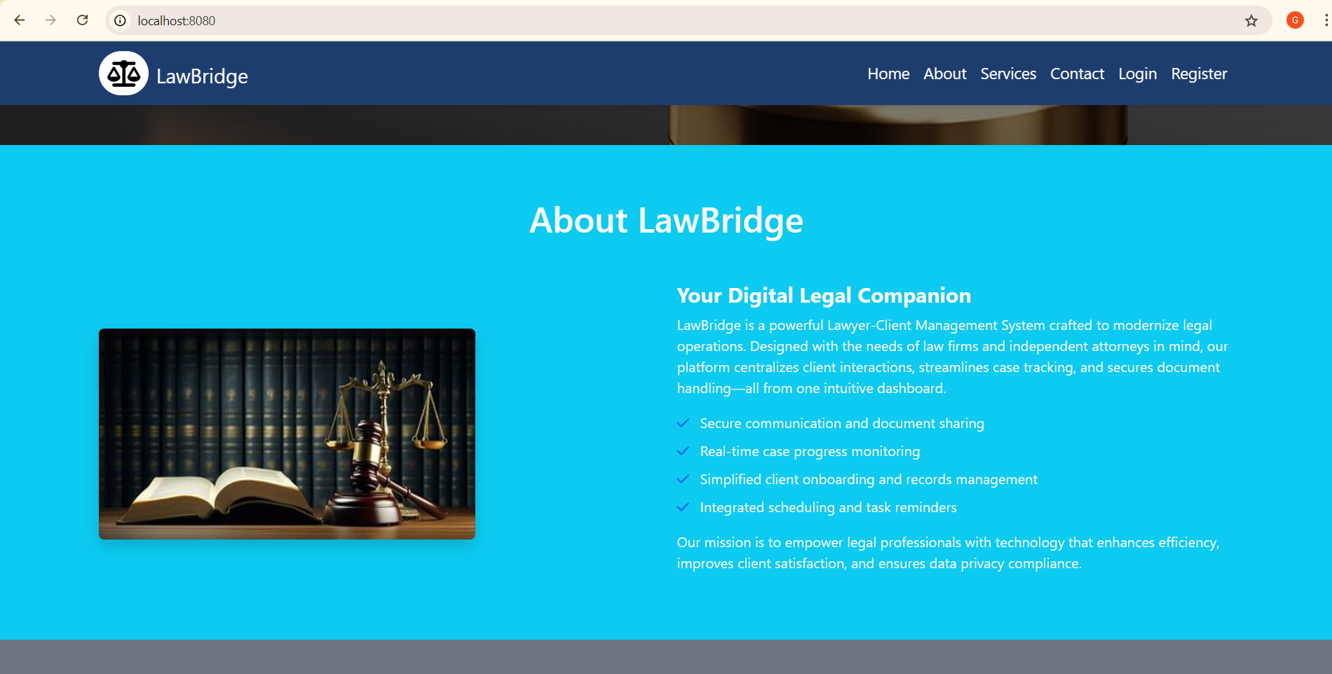
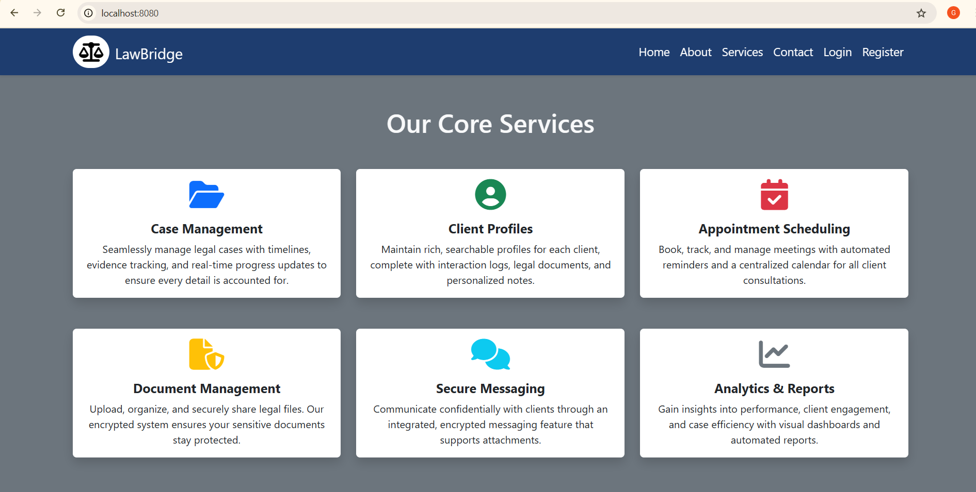
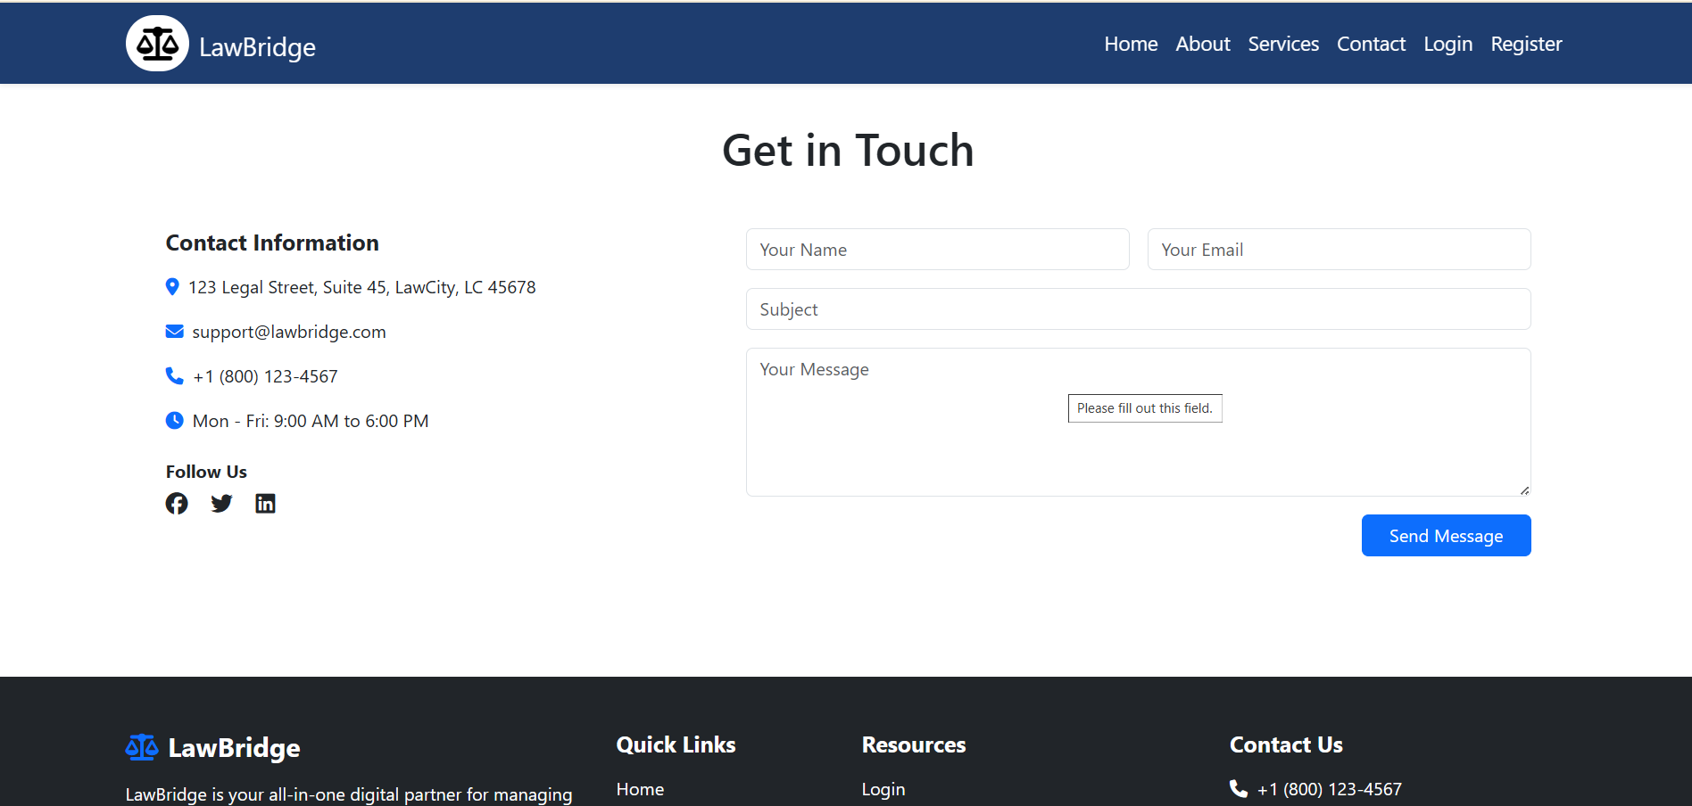

Slide 20
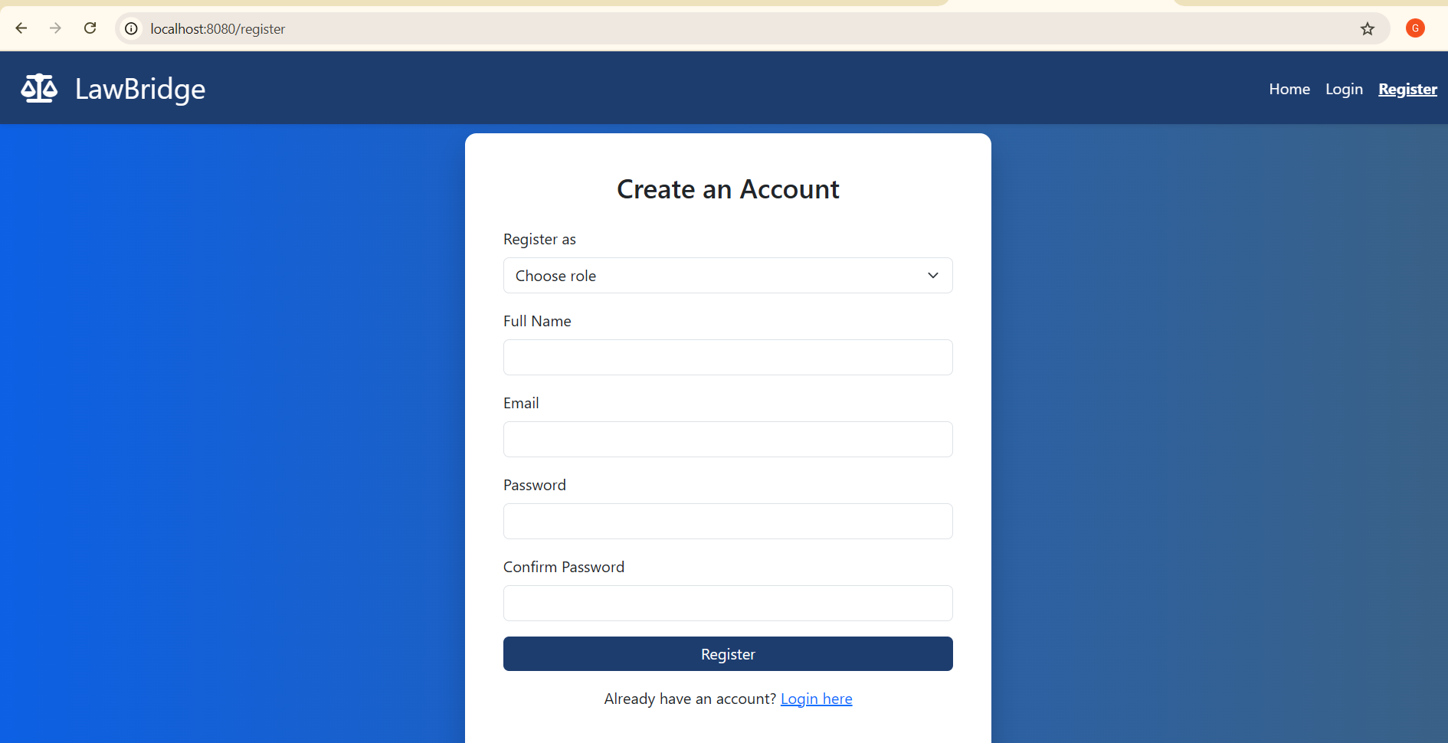
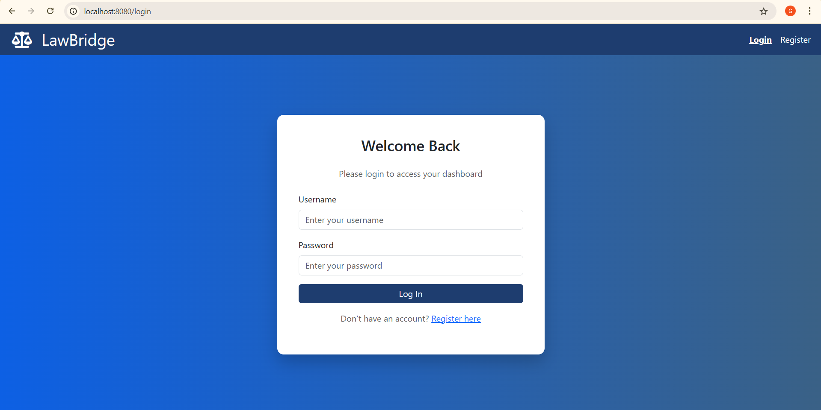
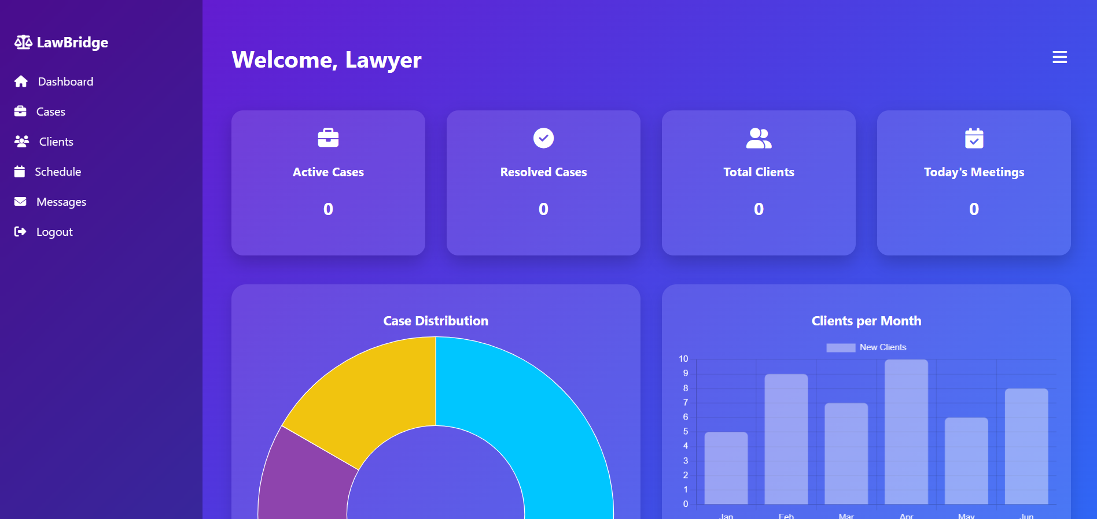
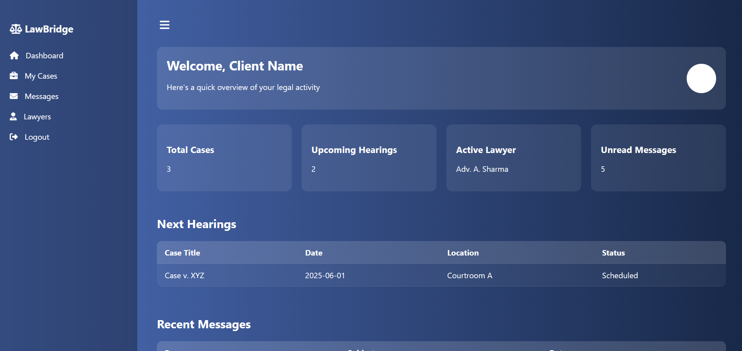

Slide 21
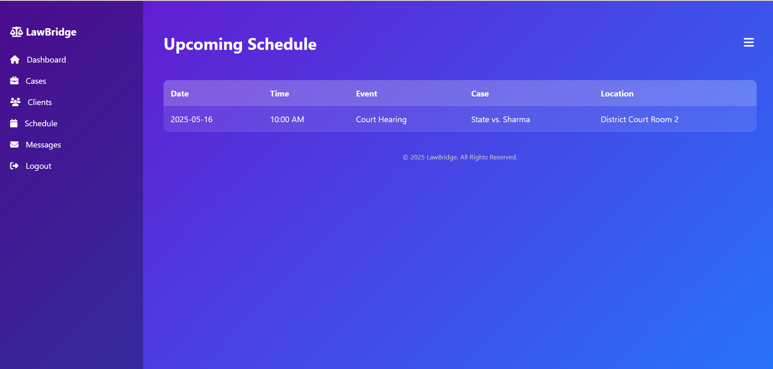
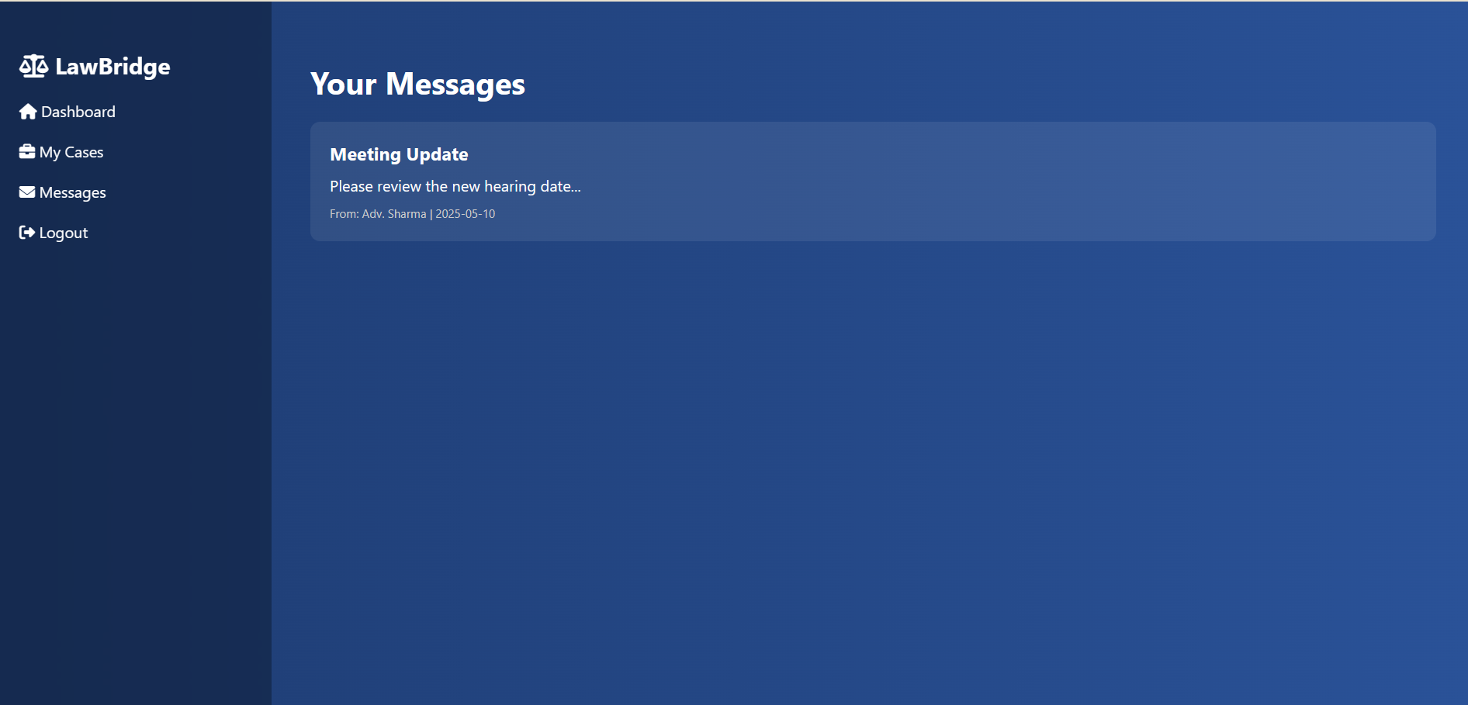
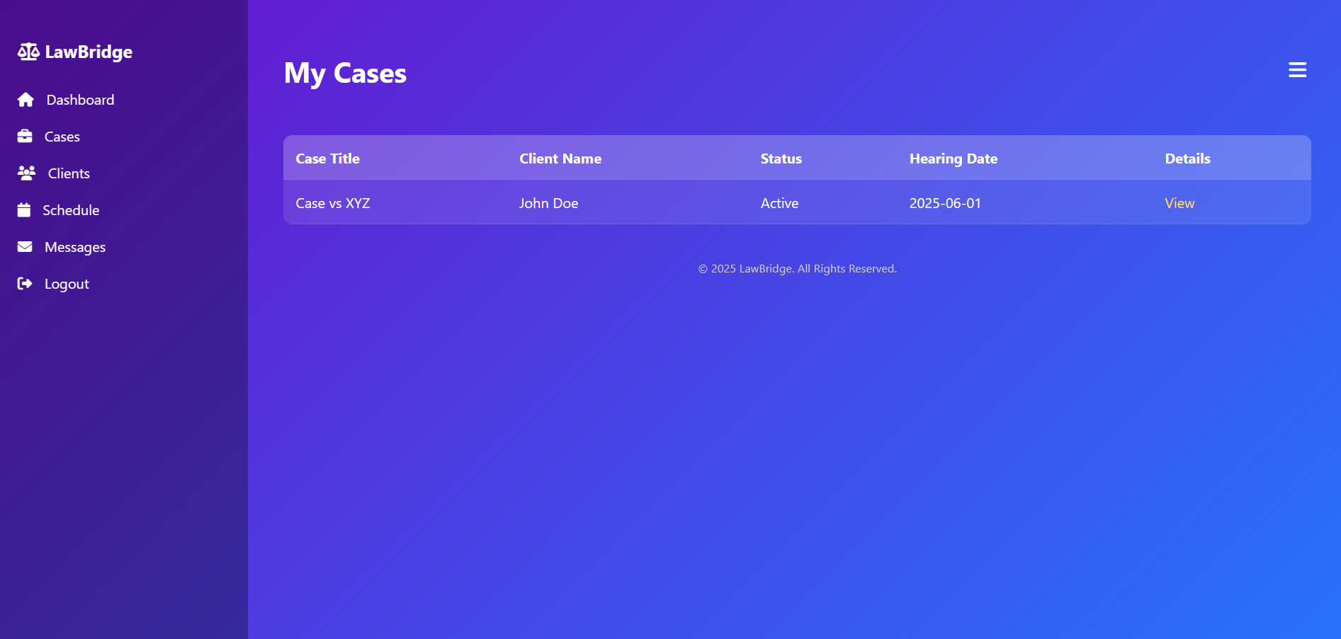
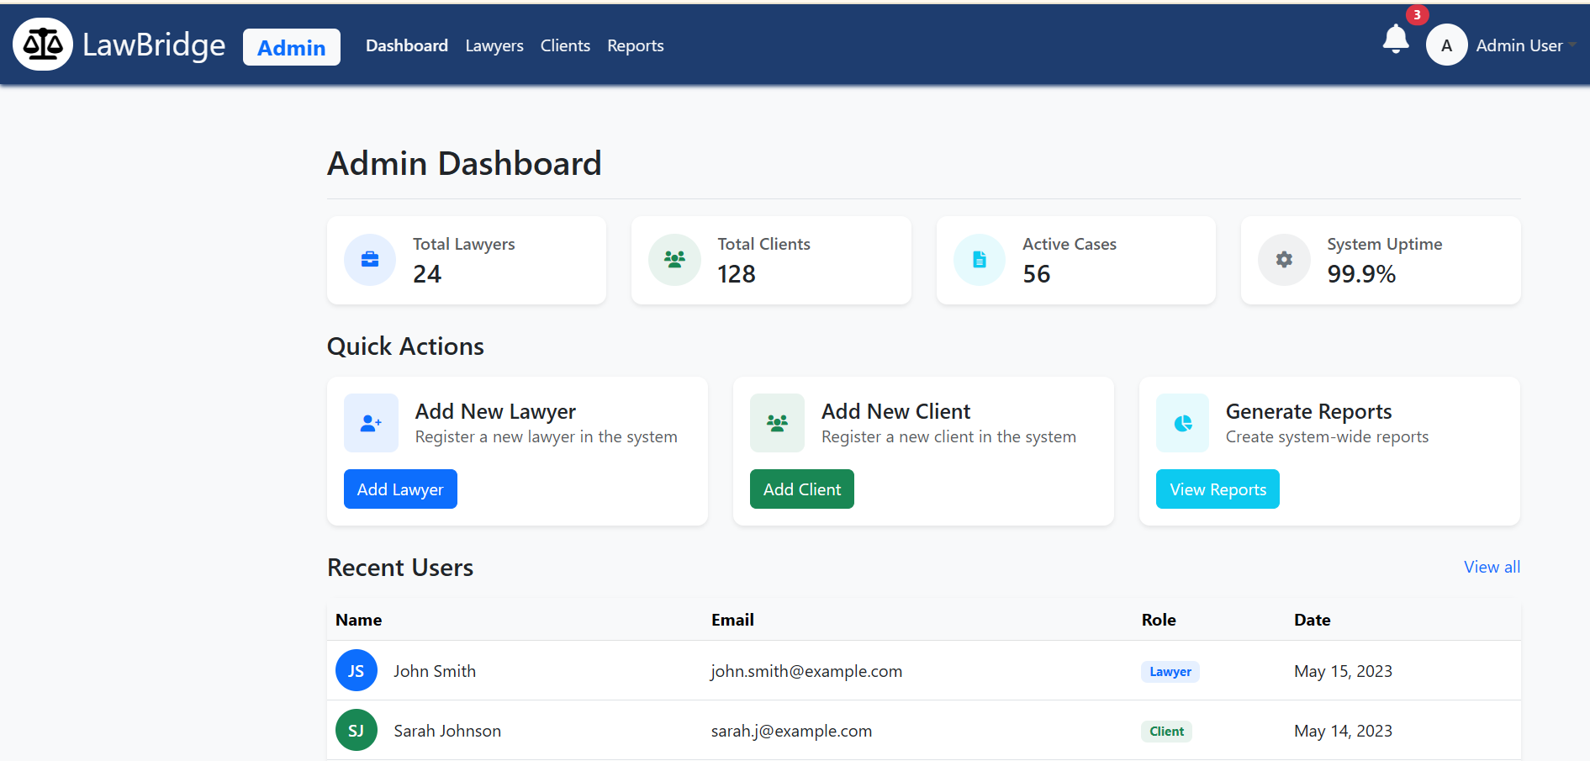
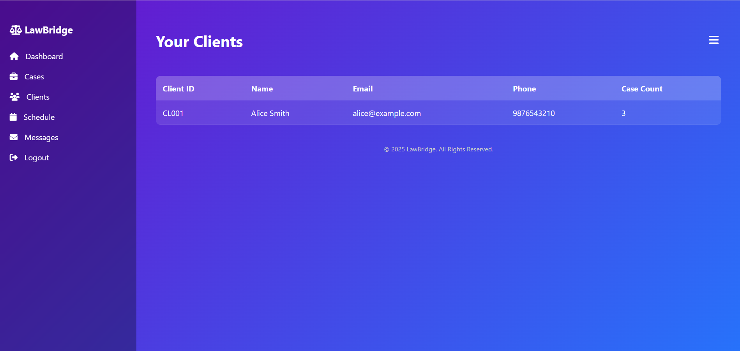
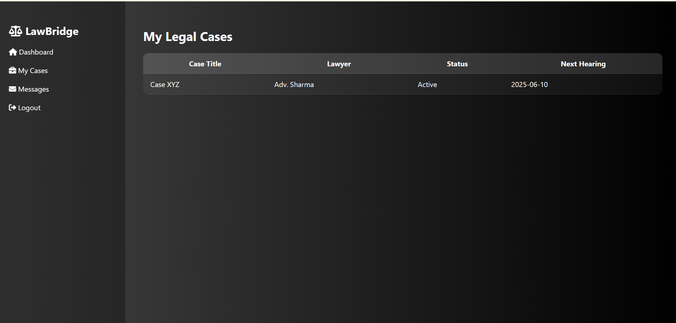

Slide 22

09
Challenges & Solutions

Slide 23



Project Challenges
Design
UI/UX
Dynamic data
Managing Roles
Handling
Between Admin Lawyer and Client
2
1
3

Slide 24

10
Conclusion

Slide 25

Project Summary
1
Project Benefits
Streamlines case and client tracking for lawyers.
Improves communication and transparency with clients.
Reduces paperwork and manual data handling.
2
Future Enhancements
Document Upload & Management
Allow users to upload and share legal documents securely.
Notification System
Email/SMS notifications for hearing dates and case updates.
Mobile App Integration
Develop a mobile version of the platform for on-the-go access.
Payment Gateway
Integration for billing, retainer fees, and online payments.
AI-Based Case Suggestion
Use AI to recommend similar past cases or legal strategies.

Slide 26

Thank You

